Slide 1

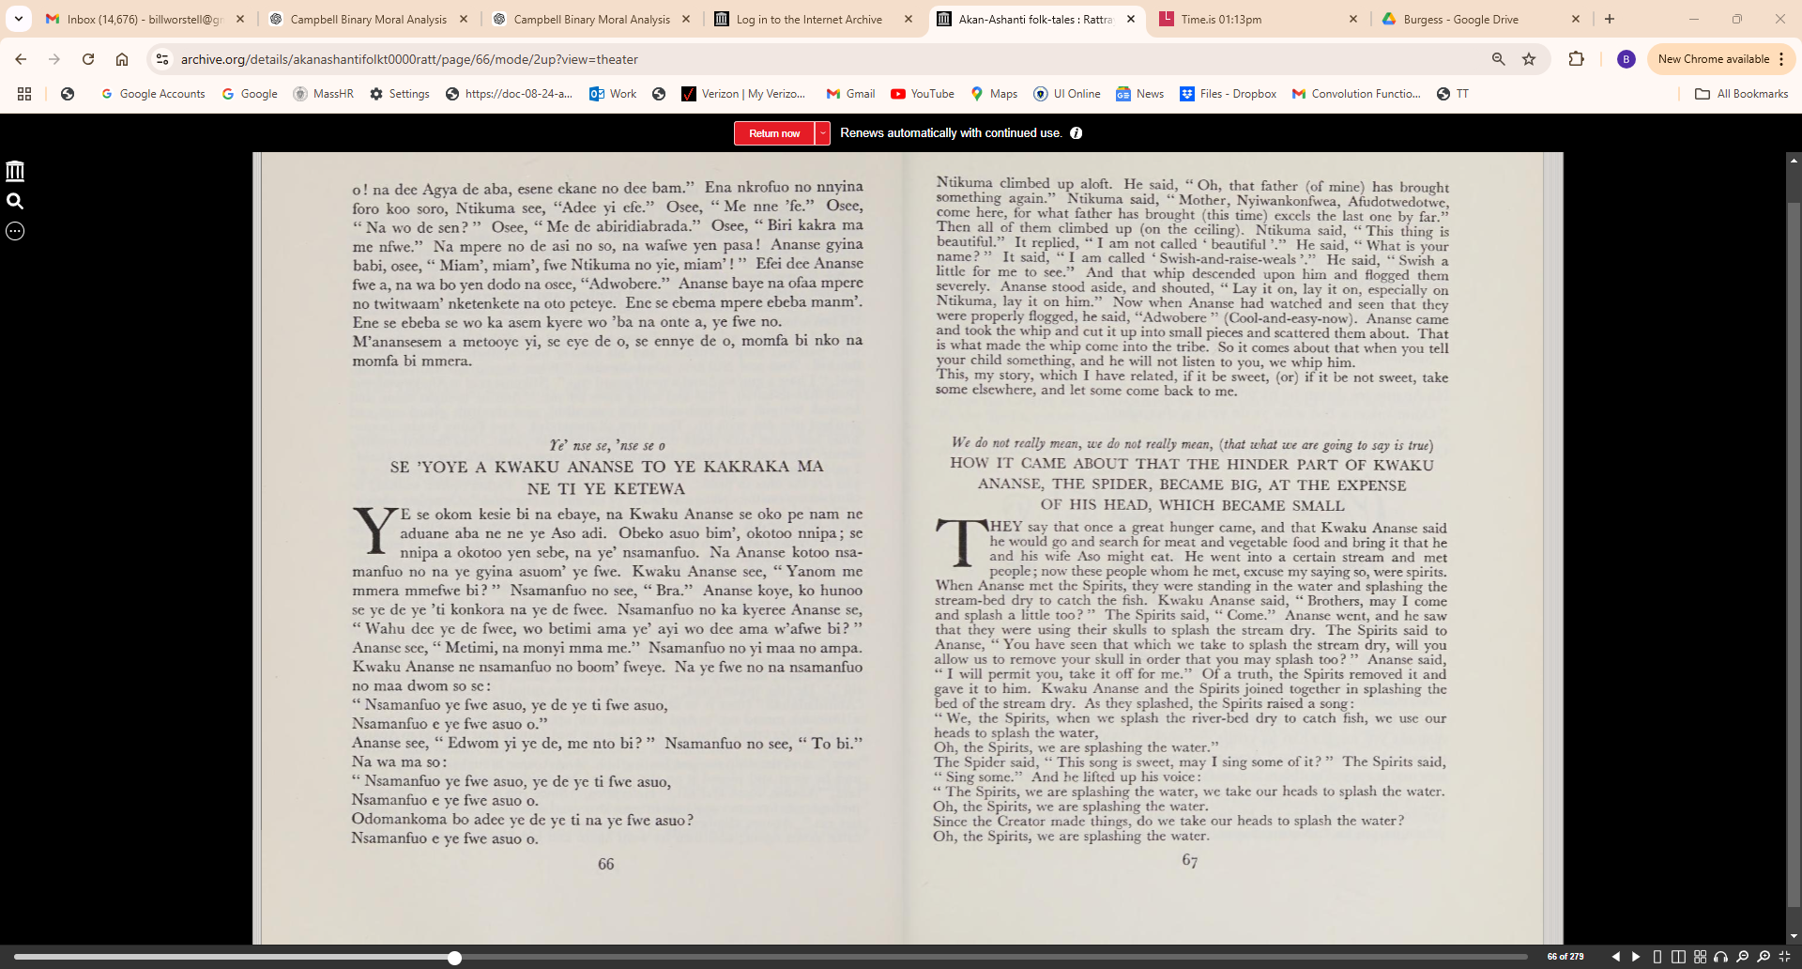

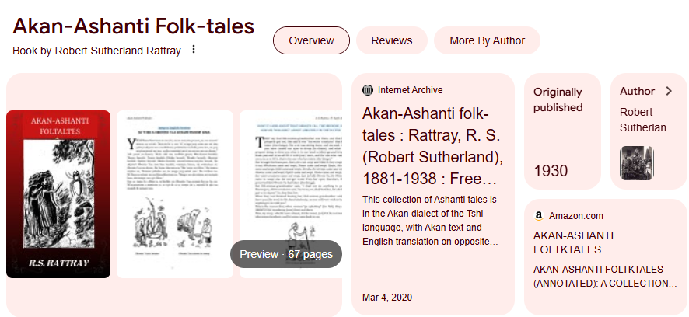
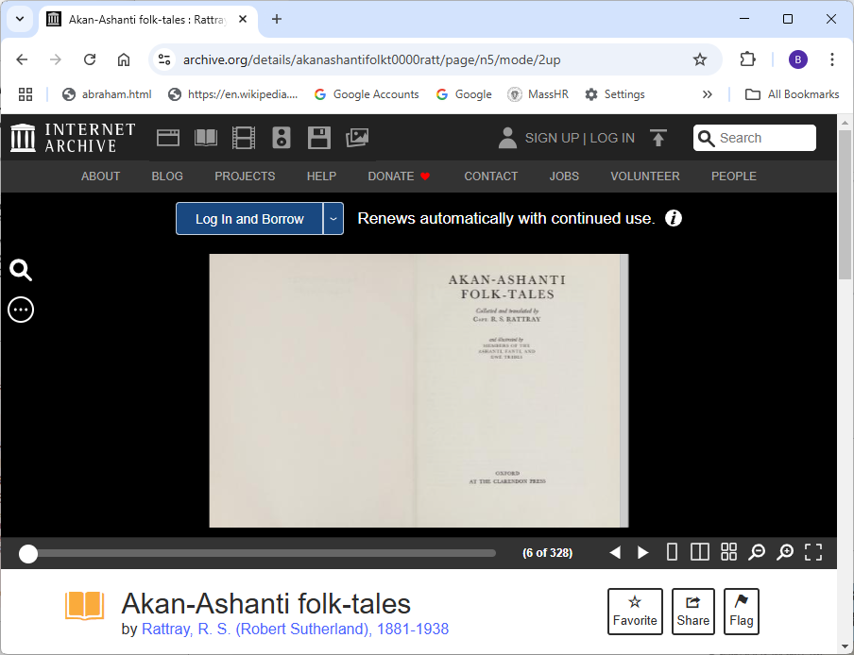
Demo Source Material:
https://archive.org/details/akanashantifolkt0000ratt/page/n5/mode/2up

Slide 2
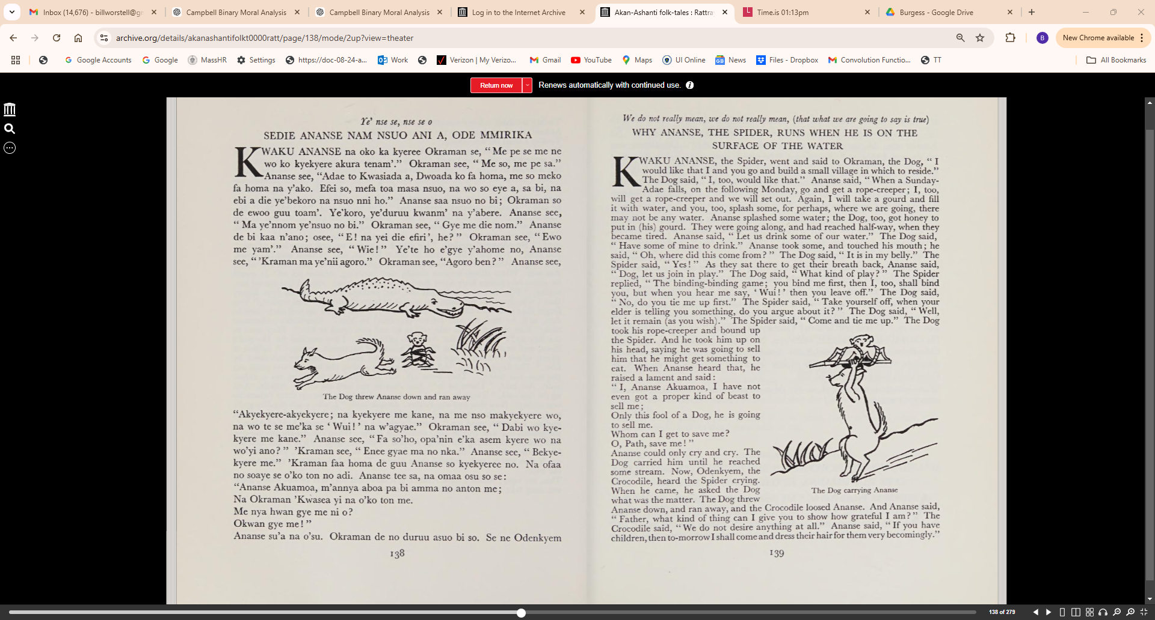

Slide 3
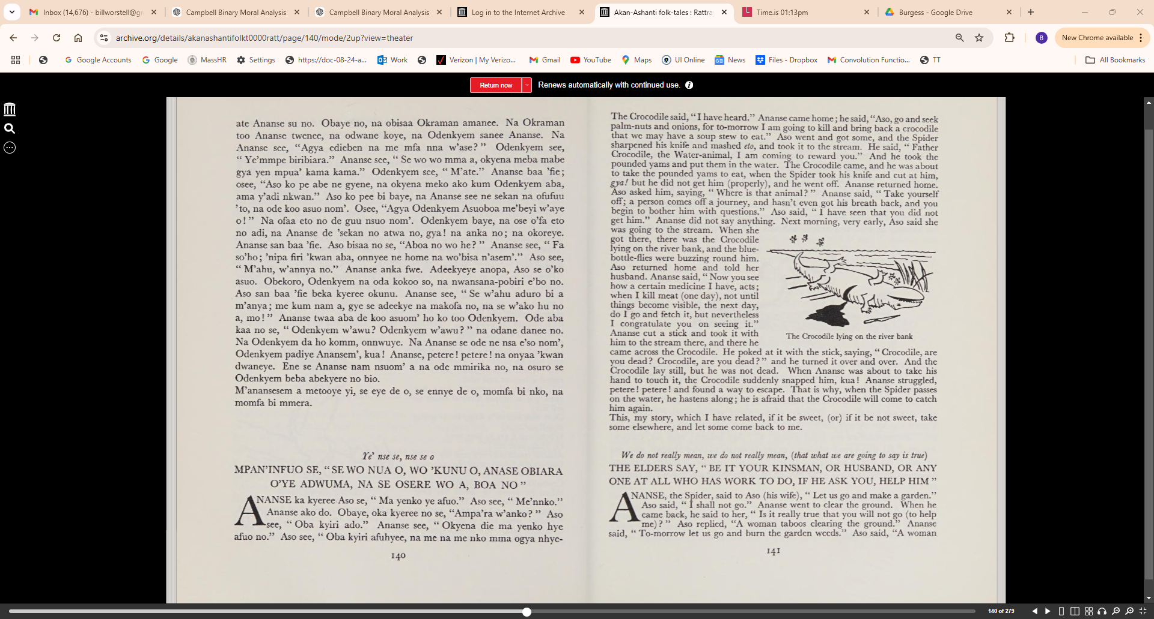

Slide 4
Ye' nse se, nse se o
SEDIE ANANSENAM NSUO ANI A, ODE MMIRIKA
KWAKU ANANSE na oko ka kyeree Okraman se, " Me pe se me ne wo ko kyekyere akura tenam'." Okraman see, "Me so, me pe sa."
Ananse see, "Adae to Kwasiada a, Dwoada ko fa homa, me so meko fa homa na y'ako. Efei so, mefa toa masa nsuo, na wo so eye a, sa bi, na ebi a die ye'bekoro na nsuo nni ho." Ananse saa nsuo no bi; Okraman so de ewoo guu toam'. Ye'koro, ye'duruu kwanm' na y'abere. Ananse see, "Ma ye'nnom ye'nsuo no bi." Okraman see," Gye me die nom." Ananse de bi kaa n'ano; osee, "E ! na yei die efiri ', he? " Okraman see, " Ewo me yam'." Ananse see, "Wie!" Ye'te ho e'gye y'ahome no, Ananse see, "'Kraman ma ye'nii agoro." Okraman see, "Agoro hen?" Ananse see, "Akyekyere-akyekyere; na kyekyere me kane, na me nso makyekyere wo, na wo te se me'ka se 'Wui!' na w'agyae." Okraman see," Dabi wo kye­ kyere me kane." Ananse see, "Fa so'ho, opa'nin e'ka asem kyere wo na wo'yi ano?" 'Kraman see," Ence gyae ma no nka." Ananse see," Bekye­ kyere me." 'Kraman faa homa de guu Ananse so kyekyeree no. Na ofaa no soaye se o'ko ton no adi. Ananse tee sa, na omaa osu so se :
"Ananse Akuamoa, m'annya aboa pa bi amma no anton me; Na Okraman 'Kwasea yi na o'ko ton me.
Me nya hwan gye me ni o? Okwan gye me! "
Ananse su'a na o'su. Okraman de no duruu asuo bi so. Se ne Odenkyem
ate Ananse su no. Obaye no, na obisaa Okraman amanec. Na Okraman
too Ananse twence, na odwane koye, na Odenkyern sance Ananse. Na
Ananse see, "Agya edieben na me mfa nna w'ase? " Odenkyem see,
" Ye'mmpe biribiara." Ananse see, " Se wo wo mma a, okyena meba mabe
gya yen mpua' kama kama." Odenkyem see, " M'ate." Ananse baa 'fie;
osee, "Aso ko pe abe ne gyene, na okyena meko ako kum Odenkyem aba,
ama y'adi nkwanY Aso ko pee bi baye, na Ananse see ne sekan na ofufuu
'to, na ode koo asuo nom'. OseeJ. "Agya Odenkyem Asuoboa me'beyi Vaye
o! " Na ofäa eto no de guu nsuo nom'. Odenkyem baye, na ose oTa eto
no adi, na Ananse de 'sekan no atwa no, gya! na anka no; na okoreye.
Ananse san baa 'fie. Aso bisaa no se, "Aboa no wo he? " Ananse see, " Fa
so'ho; nipa firi lwan aba, onnyee ne home na wolisa n'asern'Y Aso see,
" M'ahu, w'annya noY Ananse anka fwe. Adeekyeye anopa, Aso se olo
asuo. Obekoro, Odenkyem na oda kokoo so, na nwansana-pobiri elo no.
Aso san baa 'fie beka kyeree okunu. Ananse see, " Se w'ahu aduro bi a
myanya; me kum nam a, gye se adeckye na makofa no, na se wako hu no
a. mo i " Ananse twaa aba de koo asuom' ho ko too Odenkyem. Ode aba
kaa no se, " Odenkyem w'awu? Odenkyem w'awu? " na odane danee no.
Na Odenkyem da ho komm, onnwuye. Na Ananse se ode ne nsa e'so nom,,
Odenkyem padiye Anansem', kua! Ananse, petere! petere! na onyaa'kwan
dwaneye. Ene se Ananse nam nsuom' a na ode mmirika no, na osuro se
Odenkyem beba abekyere no bio.
M'anansesem a metooye yi, se eye de o, se ennye de o, momfa bi nko, na
momfa bi mmera.

Slide 5
We do not real{), mean, we do not real[y mean, (that what we are going to say is true)
WHY ANANSE, THE SPIDER, RUNS WHEN HE IS ON THE SURFACE OF THE WATER
KWAKU ANANSE, the Spider, went and said to Okraman, the Dog," I would like that I and you go and build a small village in which to reside." The Dog said," I, too, would like that." Ananse said, "When a Sunday­ Adae falls, on the following Monday, go and get a rope-creeper; I, too,
will get a rope-creeper and we will set out. Again, I will take a gourd and fill it with water, and you, too, splash some, for perhaps, where we are going, there may not be any water. Ananse splashed some water; the Dog, too, got honey to put in (his) gourd. They were going along, and had reached half-way, when they became tired. Ananse said, "Let us drink some of our water." The Dog said, " Have some of mine to drink." Ananse took some, and touched his mouth; he said, " Oh, where did this come from?" The Dog said, "It is in my belly." The Spider said, " Yes! " As they sat there to get their breath back, Ananse said, " Dog, let us join in play." The Dog said, " What kind of play? " The Spider replied, " The binding-binding game; you bind me first, then I, too, shall bind you, but when you hear me say, 'Wui ! ' then you leave off." The Dog said, "No, do you tie me up first." The Spider said, "Take yourself off, when your elder is telling you something, do you argue about it?" TheDog said, "Well, let it remain (as you wish)." The Spider said," Come and tie me up." The Dog took his rope-creeper and bound up
the Spider. And he took him up on his head, saying he was going to sell him that he might get something to eat. When Ananse heard that, he raised a lament and said:
" I, Ananse Akuamoa, I have not even got a proper kind of beast to sell me;
Only this fool of a Dog, he is going to sell me.
Whom can I get to save me? 0, Path, save me! "
Ananse could only cry and cry. The Dog carried him until he reached some stream. Now, Odenkyem, the Crocodile, heard the Spider crying.
When he came, he asked the Dog what was the matter. The Dog threw
Ananse down, and ran away, and the Crocodile loosed Ananse. And Ananse said, "Father, what kind of thing can I give you to show how grateful I am?" The Crocodile said, "We do not desire anything at all." Ananse said, "If you have children, then to-morrow I shall come and dress their hairfor them very becomingly."
The Crocodile said, "I have heard." Ananse came home; he said, "Aso, go and seek
palm-nuts and onions, for to-morrow I am going to kill and bring back a crocodile
that we may have a soup stew to eat." Aso went and got some, and the Spider
sharpened his knife and mashed eto, and took it to the stream. He said, " Father
Crocodile, the Water-animal, I am coming to reward you." And he took the
pounded yams and put them in the water. The Crocodile came, and he was about
to take the pounded yams to eat, when the Spider took his knife and cut at him,
gyal but he did not get him (properly), and he went off. Ananse returned home.
Aso asked him, saying, "Where is that animal? " Ananse said, " Take yourself
off; a person comes off a journey, and hasn't even got his breath back, and you
begin to bother him with questions." Aso said, " I have seen that you did not
get him." Ananse did not say anything. Next morning, very early, Aso said she
was going to the stream. When she
got there, there was the Crocodile * ,
lying on the river bank, and the blue
bottle-flies were buzzing round him.
Aso returned home and told her
husband. Ananse said, "Now you see
how a certain medicine I have, acts;
when I kill meat (one day), not until
things become visible, the next day,
do I go and fetch it, but nevertheless
I congratulate you on seeing it."
Ananse cut a stick and took it with
him to the stream there, and there he
came across the Crocodile. He poked at it with the stick, saying, "Crocodile, are
you dead? Crocodile, are you dead?" and he turned it over and over. And the
Crocodile lay still, but he was not dead. When Ananse was about to take his
hand to touch it, the Crocodile suddenly snapped him, kua! Ananse struggled,
petere! petere! and found a way to escape. That is why, when the Spider passes
on the water, he hastens along; he is afraid that the Crocodile will come to catch
him again.
This, my story, which I have related, if it be sweet, (or) if it be not sweet, take
some elsewhere, and let some come back to me.

